Slide 1
Bone Mineral Disorder: Calcium, Vitamin D and Phosphorus
This webinar will start shortly. The slides and the webinar recording will be available at www.dpcedcenter.org
Next webinar: July 30,2020 J

Slide 2
Today’s Presenter
Registered Dietitian for over 6 years
Board Certified Specialist Renal Dietitian
  + 4 years of experience in dialysis
  Patients with CKD
2x presenter at Annual Symposium of the National Association of Nephrology Technicians in Las Vegas, NV
Advocate for patients access to dialysis in California (SB 341 and Prop 8)

Slide 3
Objectives
Learn relationship between kidney disease and your bones
Review renal bone mineral disease
Discuss how diet impacts renal bone mineral disorder
  Foods to avoid
  How to improve your diet to help slow down progression of this disorder

Slide 4
Introduction
CKD affects ~15% of the United States population
1 in 7 American adults have CKD
Leading causes: uncontrolled diabetes and hypertension
CKD
  Kidney damage that last > 3 months
  Reduction in kidney function
    Structural or functional abnormalities must be present
  Stage classified based on residual kidney function

Slide 5
Functions of the Kidney
Excretion
  Remove excess of fluid and waste products (urea, vitamins, minerals)
Acid-balance of the blood:
  Maintaining blood and urine pH.
Endocrine
  Calcitriol: active form of Vitamin D3, which helps with calcium absorption
  Erythropoietin: increases production of red bloods cells
Notes:
Excretion: remove excess of fluid and waste products (urea, vitamins, minerals)
Acid-balance of the blood: maintaining blood and urine pH. No need to use detox or alkaline water because the kidneys to this already.
Endocrine
Calcitriol (active form of Vitamin D3, which and helps with calcium absorption). This involves the minerals phosphorus and calcium.
Erythropoietin: increases production of red bloods cells (anemia), it is the reason why patient with CKD present anemia problems and feel tired. In this case, levels do not react to dietary iron and an injectable form of Iron and this hormone it’s necessary to address the issue.

Slide 6
Endocrine function the kidneys
Hormonal function
  Feedback method.
  Activation of Vitamin D promotes the absorption of dietary Calcium in the gut.
  Small changes in the calcium blood levels stimulate a hormone called Parathyroid hormone (PTH).
    Helps to release calcium from bone into the blood
    Activate Vitamin D, which stimulates absorption of the calcium from the intestines
    Reduces renal absorption of phosphorus and increases excretion of phosphorus
Notes:
Function of the kidneys- feedback method, activation of Vitamin D helps with the absorption of dietary Calcium in the gut (intestine). When the kidney function starts decreasing, the activation of Vitamin D by the kidney gets affected and this causes the calcium levels in the blood to decrease as well. In this step, phosphorus absorption by the intestine gets affected as well, causing the bone to release both calcium and phosphorus. As a compensatory method, a gland call Parathyroid, produces a hormone responsible of obtaining calcium from the bone to restore the adequate balance in the blood. However this with time causes bone resorption. As renal disease advances, more bone resorption occurs which causes damage and structural changes to the bone, and this lead to hypercalcemia, microfractures and loss of bone density.
Physiology
Small changes in extracellular ionized calcium concentrations stimulate PTH production.
PTH helps to release calcium into the blood from bone through bone resorption
PTH stimulate kidneys to reabsorb calcium and activate Vitamin d, which stimulates absorption of the calcium from the intestines.
PTH also reduces renal absorption of phosphorus and increases excretion of phosphorus

Slide 7
Renal Bone Mineral Disease

Slide 8
Renal Bone Mineral Disease
Early Stage 2 CKD
Decrease of the Vitamin D activation by the kidneys
PTH levels increase
Calcium and phosphorus levels usually do not change at this point
Notes:
Pathophysiology
Everything starts with a decrease of the Vitamin D activation by the kidneys, which causes an increase in PTH levels, even before calcium and phosphorus levels begin to change (Early Stage 2)
Late stage 3 CKD, Vitamin D levels are below level range and PTH levels are slightly increased.
As disease progresses, parathyroid glands over grow which continues producing even more PTH.
With time this leads to loss of bone density and mineral loss from bone.
Arterial stiffening
Vascular calcifications
Metastatic calcifications of soft tissues
Calciphylaxis
Increased morbidity and morbidity
Erythropoietin-resistant anemia
Usually no symptoms or symptoms appear late in the process
Pain
Stiffness in joint
Higher risk of fracture
Spontaneous tendon rapture

Slide 9
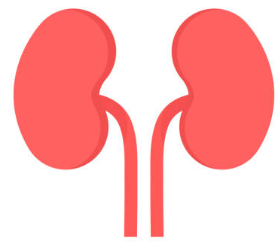
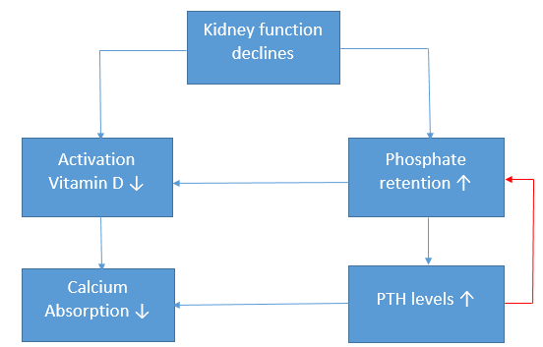
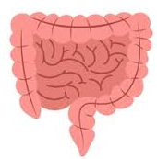
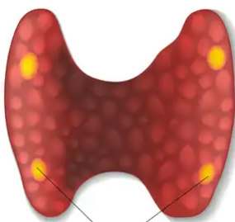
Endocrine function the kidneys

Slide 10
Renal Bone Mineral Disease
Late stage 3 CKD
Vitamin D levels drop below normal range and PTH levels are slightly increased
Parathyroid glands overgrow and this results in overproduction of PTH
  Secondary Hyperthyroidism
Leads to loss of bone density and mineral loss from bone.
Symptoms:
  Pain
  Stiffness in joint
  Higher risk of fracture
  Spontaneous tendon rapture
Vit. D
PTH

Slide 11
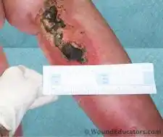
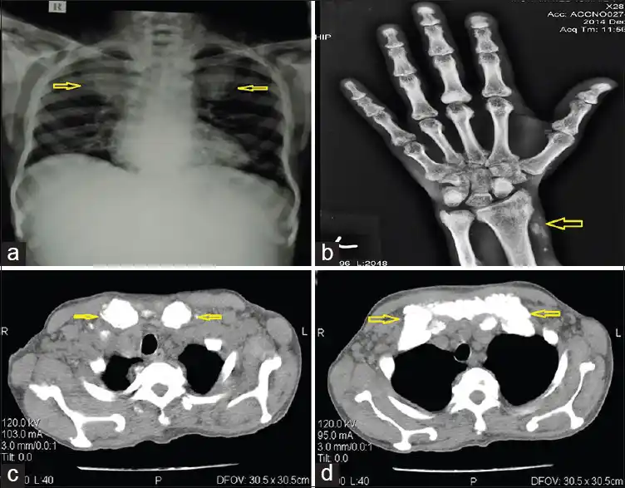
Long-term implications:
Calciphylaxis
Vascular and soft tissue calcifications
Increased morbidity and mortality
Image courtesy of woundeducator.com
Image courtesy of the Journal Association of Chest Physicians

Slide 12
What causes Bone Mineral Disorder?
Abnormal calcium and phosphorus metabolism
Vitamin D deficiency
Secondary Hyperthyroidism (SHTP)
Notes:
Types of Renal Disease
High-turnover bone disease Osteotitis fibrosa
Result of SHTP
Increase of osteoblast and osteoclasts, which increases bone formation and resorption rates
High PTH, Metabolic Acidosis and hyperphosphatemia
Factors that lead to excessive PTH secretion:
Altered Vitamin D metabolism-changes in the calcium level of extracellular fluid influences synthesis of calcitriol (1,25 dihydorxyvitamin D) and the secretion of PTH. Calcitriol increases intestinal calcium absorption in response to low calcium and PTH can directly stimulate renal tubules to increase calcitriol production
Hypocalcemia-worsens due to lower active transport of calcium from intestine leaving primarily only passive absorption of calcium. Also affected by higher phosphorus levels, which stimulates PTH production and inhibit action of calcitriol. This results in hyperphosphatemia, hypocalcemia and calcitriol deficiency, which all leads parathyroid hyperplasia. Calcium is the most important regulator of PTH secretion, powerful stimulant of PTH secretion.
Phosphorus retention-increase in both excretion and production of phosphorus and calcitriol production, in response to an increased secretion of PTH (reason why phosphorus levels usually remain within normal range during stage 2-3 CKD; this changes in stage 4 CKD). Phosphorus stimulates synthesis and secretion of PTH independent of calcitriol or serum Calcium. PO4 also stimulates hyperplasia of the parathyroid gland (IMPORTANT LOW PO4 DIET TO DECREASE PTH PRODUCTION). A HIGH PHOSPHORUS DIET RESULTS IN RAPID PARATHYROID CELL GROWTH (HYPERPLASIA). Hyperphosphatemia also causes resistance to calcitriol therapy. SHTP-high serum phosphorus levels from dietary phosphorus intake and phosphorus coming from bone due to bone resorption.
Skeletal resistance to PTH-resistance to the calcemic action of PTH occurs early in CKD
Reduced degradation of PTH-related to increased secretion of PTH, decreased catabolism of PTH (kidneys degrade PTH). High levels of iPTH result partially from increased secretion as well as from decreased catabolism secondary to the decreased number of nephrons.
Metabolic acidosis-starts at stage 2 CKD, low CO2 levels. Chronic metabolic acidosis alters bone composition and alter the hemostatic relationship between blood ionized calcium, PTH and 1,25(OH)₂D
Mixed-uremic bon diseases
Combination of high turnover bone disease and osteomalacia
High and low remodeling activities, defective mineralization with or without increased bone formation.
Lower formation and mineralization rate as compared with high turnover disease.
Factors:
Increased PTH activity, metabolic acidosis, calcium and calcitriol deficiency, aluminum toxicity, skeletal resistance to Vitamin D and PTH, and hyperphosphatemia.
Very-low turnover bone disease adynamic bone
Osteomalacia: low rates of bone turnover, osteoid accumulation and defective mineralization. Common cause: aluminum toxicity and other heavy metals. Also associated with Vitamind D deficiency, profound hypophosphatemia, hypocalcemia, and severe acidosis
Adynamic Bone disease: low bone activity, decreased bone formation and resorption. Associated with suppression of PTH by the use of calcium, active vitamin D, and vitamin D analogue.

Slide 13
Types of Renal bone disease
1. High-turn over
  Caused by SHTP
  Increase bone formation and resorption rates
    High PTH levels
    Metabolic Acidosis
    Hyperphosphatemia
  Factors that lead to excessive PTH secretion:
    Altered Vitamin D metabolism
    Hypocalcemia
    Phosphorus retention ***
    Skeletal resistance to PTH
    Reduced degradation of PTH
    Metabolic acidosis
Notes:
Factors that lead to excessive PTH secretion:
Altered Vitamin D metabolism-changes in the calcium level of extracellular fluid influences synthesis of calcitriol (1,25 dihydorxyvitamin D) and the secretion of PTH. Calcitriol increases intestinal calcium absorption in response to low calcium and PTH can directly stimulate renal tubules to increase calcitriol production
Hypocalcemia-worsens due to lower active transport of calcium from intestine leaving primarily only passive absorption of calcium. Also affected by higher phosphorus levels, which stimulates PTH production and inhibit action of calcitriol. This results in hyperphosphatemia, hypocalcemia and calcitriol deficiency, which all leads parathyroid hyperplasia. Calcium is the most important regulator of PTH secretion, powerful stimulant of PTH secretion.
Phosphorus retention -increase in both excretion and production of phosphorus and calcitriol production, in response to an increased secretion of PTH (reason why phosphorus levels usually remain within normal range during stage 2-3 CKD; this changes in stage 4 CKD). Phosphorus stimulates synthesis and secretion of PTH independent of calcitriol or serum Calcium. PO4 also stimulates hyperplasia of the parathyroid gland (IMPORTANT LOW PO4 DIET TO DECREASE PTH PRODUCTION). A HIGH PHOSPHORUS DIET RESULTS IN RAPID PARATHYROID CELL GROWTH (HYPERPLASIA). Hyperphosphatemia also causes resistance to calcitriol therapy. SHTP-high serum phosphorus levels from dietary phosphorus intake and phosphorus coming from bone due to bone resorption.
Skeletal resistance to PTH -resistance to the calcemic action of PTH occurs early in CKD
Reduced degradation of PTH -related to increased secretion of PTH, decreased catabolism of PTH (kidneys degrade PTH). High levels of iPTH result partially from increased secretion as well as from decreased catabolism secondary to the decreased number of nephrons.
Metabolic acidosis -starts at stage 2 CKD, low CO2 levels. Chronic metabolic acidosis alters bone composition and alter the hemostatic relationship between blood ionized calcium, PTH and 1,25(OH)₂D

Slide 14
Types of Renal bone disease
2. Mixed-uremic bone disease
  Combination of high turnover bone disease and osteomalacia
  High and low remodeling activities, defective mineralization with or without increased bone formation.
  Lower formation and mineralization rate as compared with high turnover disease.
  Factors:
    Increased PTH activity, metabolic acidosis
    Calcium and calcitriol deficiency
    Aluminum toxicity
    Skeletal resistance to Vitamin D and PTH
    Hyperphosphatemia.
Notes:
o Factors:
▪ Increased PTH activity, metabolic acidosis, calcium and calcitriol deficiency, aluminum toxicity, skeletal resistance to Vitamin D and PTH, and hyperphosphatemia.

Slide 15
Types of Renal bone disease
3. Low-turn over
  Osteomalacia:
    Low rates of bone turnover.
    Common causes: aluminum toxicity and other heavy metals. Also associated with Vitamin D deficiency, hypophosphatemia, hypocalcemia, and severe acidosis.
  Adynamic Bone disease:
    Low bone activity, decreased bone formation and resorption (brake down).
    Common cause: over suppression of PTH by the use of calcium, active vitamin D, and vitamin D analogue.

Slide 16
What can I do to prevent bone mineral disorder?
Treatment and Prevention

Slide 17
Role of phosphorus
Hyperphosphatemia
  Greatest risk factor.
  Every 1 mg/dL increase in phosphorus, there is a 10-62% increase in mortality risk.
  Higher phosphorus levels and faster decline in renal function.
Factors associated with calcification
  Higher phosphorus levels
  Higher calcium x phosphorus product
  Use of high doses of calcium-containing binders
Notes:
Vascular calcification of the aorta, peripheral and coronary arteries. Abnormal mineral metabolism-critical component of the pathogenesis o vascular calcification.
Every 1 mg/dL increase in phosphorus, there is a 10-62% increase in mortality risk.
Relationship between higher phosphorus levels and higher incidence of progressive renal disease (faster decline in renal function)
Factors associated with calcification
Higher phosphorus levels
Higher calcium x phosphorus product
Use of high doses of calcium-containing binders

Slide 18
Phosphorus control
Primary therapy in the treatment and prevention of SHTP is the controlling phosphorus levels.
Dietary management and use of phosphorus binders.
  Eliminate foods that contain the highest amount of phosphorus without while meeting protein needs.

Slide 19
Dietary phosphorus
Phosphorus Absorption
  Organic
    40-60%
    Phosphorus from plants <50%
  Inorganic
    Processed foods 90%
    Preservatives/phosphorus additives
    Enhanced meats, beverages, baked products
Cook methods also affect phosphorus availability

Slide 20
Dietary phosphorus
Phosphoric acid
Sodium phosphate
Dicalcium phosphate
Monosodium phosphate
Tricalcium phosphate

Slide 21
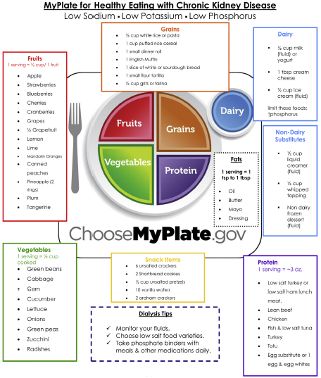

Slide 22
Phosphorus binders
Effective therapy to control phosphorus levels
Take with every meal as it helps to decrease absorption of dietary phosphorus
Does not help with phosphorus released from the bone **
Types of binders
  Calcium based binders
  Resin
    Lanthanum
    Sevelamer
  Iron-based binders

Slide 23
Vitamin D
Deficiency is common, highly common in CKD patients
  Decline in production of active Vitamin D
  Difficult to maintain adequate serum calcium levels
  Less suppression of PTH levels by active Vitamin D
  Leads to SHTP with decreased bone turnover and risk for metabolic disease

Slide 24


Questions
Please use the Chat Box

Slide 25
Thank You for Attending Today!
Please complete the Feedback Form
Join us on July 30th for our next webinar on Transplants!

